Slide 1
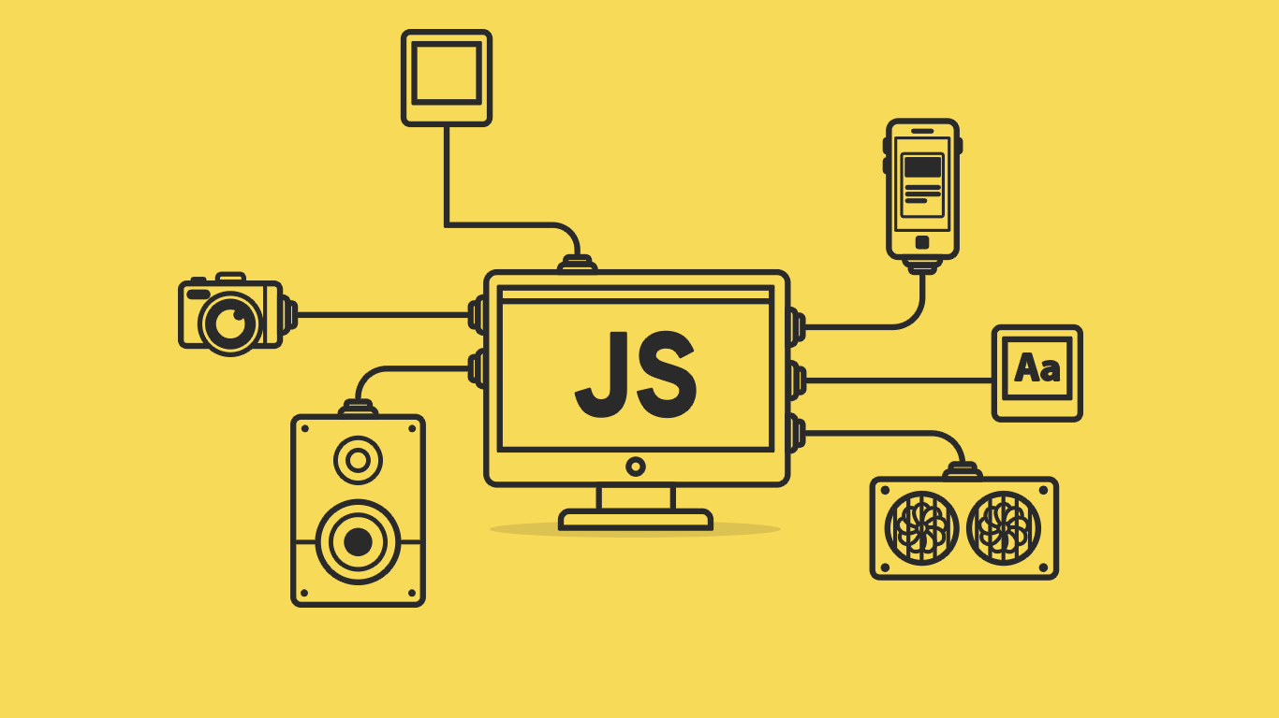

Slide 2
About today…
JavaScript Arrays
Adding element
More about Arrays

Slide 3
Introduction to Arrays
Definition
Arrays are data structures used to store multiple values in a single variable
Syntax
let arrayName = [element1, element2, element3];
Characteristics
Arrays are zero-indexed
Arrays can hold different data types
Arrays are dynamic in size

Slide 4
Creating Arrays
Empty array
let emptyArray = [];
With initial values
let fruits = ["apple", "banana", "cherry"];
Using new Array()
let numbers = new Array(1, 2, 3);

Slide 5
Accessing Array Elements
Access by index
let firstFruit = fruits[0];
Modify elements
fruits[1] = "blueberry";

Slide 6
Adding Elements to Arrays
Fruits Array
["apple", "blueberry", "cherry“]
Using push()
Adds elements to the end of the array
fruits.push("date");
Using unshift()
Adds elements to the beginning of the array
fruits.unshift("apricot");
Using array index
Adds or replaces elements at specific indices
fruits[5] = "fig";

Slide 7
Removing Elements from Arrays
Fruits Array
["apple", "blueberry", "cherry", "date"]
Fruits Array
Using pop()
Removes the last element of the array
let lastFruit = fruits.pop();
Using shift()
Removes the first element of the array
let firstFruit = fruits.shift();

Slide 8
Array Methods
Fruits Array
["apricot", "apple", "blueberry", "cherry", "date", "fig"]
Fruits Array
length
Returns the number of elements in the array
let size = fruits.length;
indexOf()
Returns the index of the first occurrence of an element
let index = fruits.indexOf("cherry");
includes()
Checks if an array contains a specified element
let hasBanana = fruits.includes("banana");

Slide 9
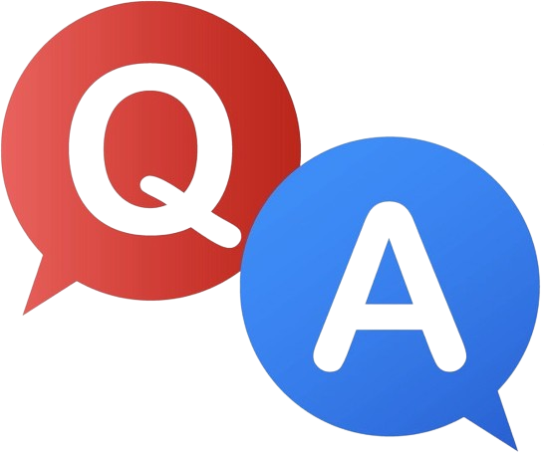

Slide 10
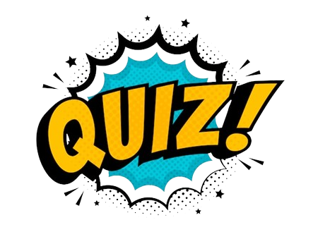
How do you add an element to the beginning of an array?
What method is used to remove the last element from an array?
What will array.length return?

Slide 11

Task 1
Create an array of your favorite books
Task 2
Add two more books to the end of the array
Task 3
Remove the first book from the array

